Slide 1

Intro to Relational Databases and SQL
Why relational databases?
Is SQL still relevant?
Retrieving data with Select queries

Slide 2
Critical infrastructure
RDS
Database
Databases are critical infrastructure
Most companies would go out of business if their database is lost / corrupted

Slide 3
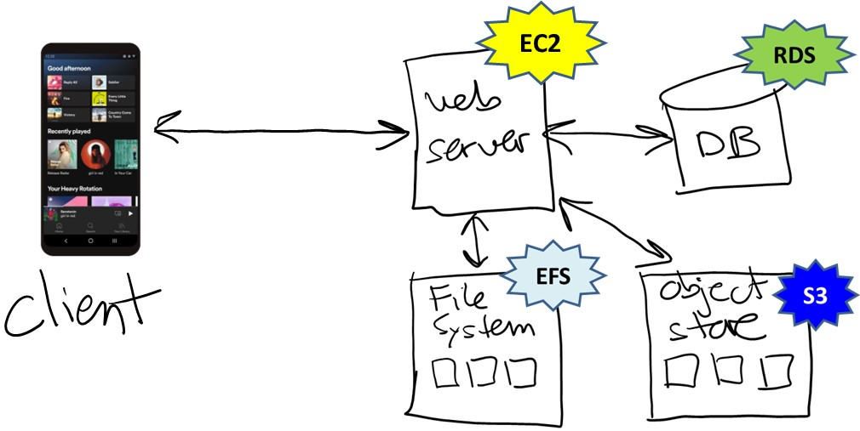
Relational Databases

Slide 4
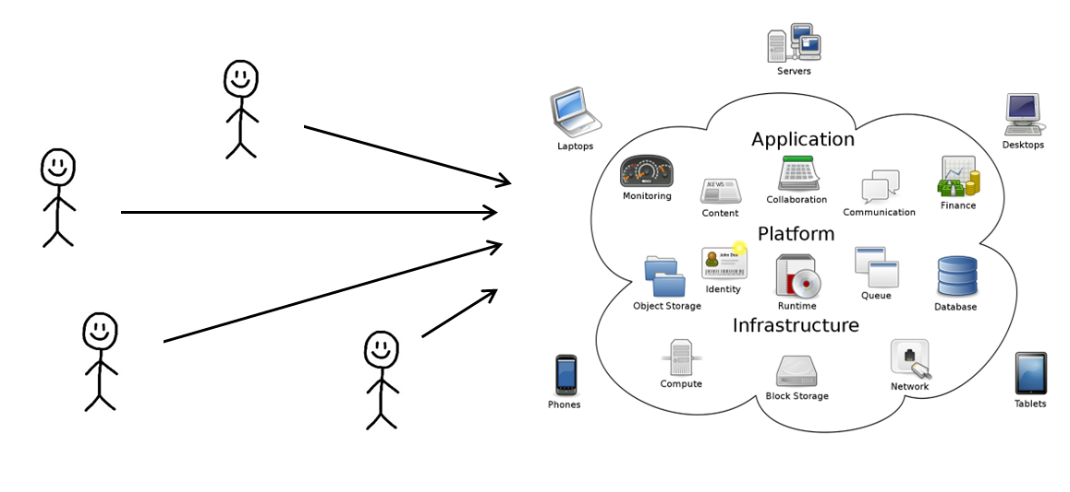
Relational databases --- pros and cons
Advantages to using relational databases?
Data is structured, clean (error-free), and well-organized
SQL is a powerful, high-level programming language
Database management systems (DBMS) are fast, efficient, and reliable

Slide 5
Disadvantages?
Disadvantages of relational databases?
Database design (schema) is rigid --- hard to evolve/change
Data cleaning for import is HARD
Difficult to scale to large amounts of data / number of users
Databases rely on a centralized model, and so replication is more difficult to engineer

Slide 6
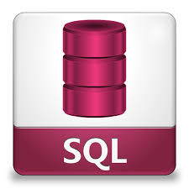
SQL
Structured Query Language
The language of relational databases
One of the most important programming languages you need to know

Slide 7
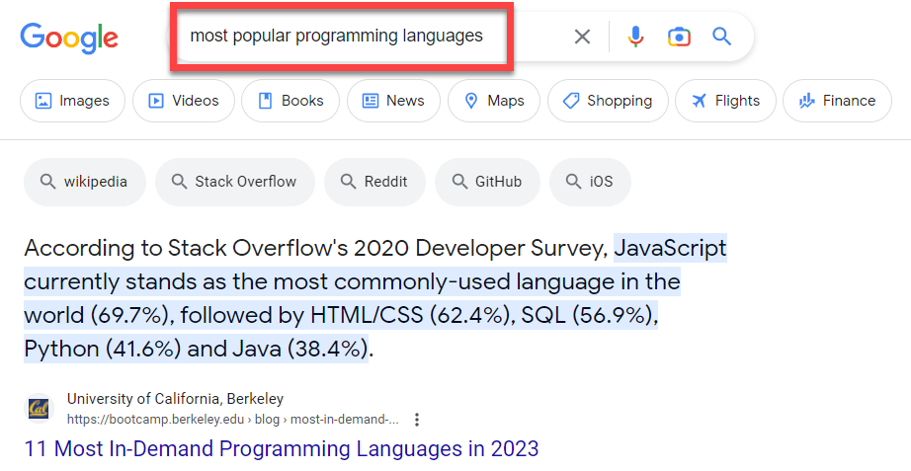
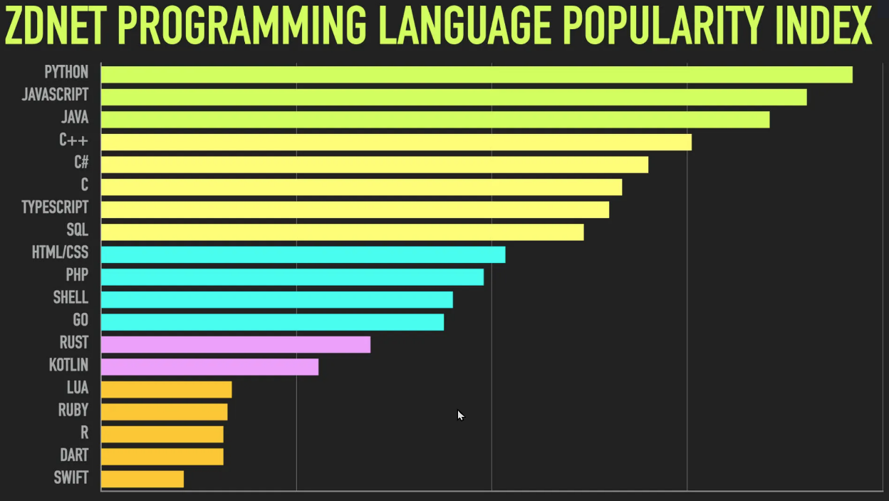
Is SQL still relevant?
Notes:
The 2nd one is fall 2024

Slide 8
Declarative Programming
Def: declarative programming is a paradigm where you express what you want, but not how — you let the system decide how best to do things.
*THE* best example of declarative programming?

Slide 9
Example
SELECT Title, PubDate FROM Books
WHERE Author = 'Stephen King'
ORDER BY PubDate DESC, Title ASC;
Title | PubDate
"Doctor Sleep" | 2014
"Revival: A Novel" | 2014
"Under the Dome: Part 2" | 2014
"Joyland" | 2013
"Salem's Lot" | 2013
"Under the Dome" | 2013
… | …
Normally we would have to handle the details of the file format… data structure… searching algorithm… sorting algorithm…

Slide 10
The SQL language is big, with 2 major sub-languages:
DDL: data definition language
DML: data manipulation language
For creating a database
Create Table
Create Index
Create Stored Procedure
…
For manipulating data in database:
Select * From … Where …
Insert
Update
Delete
…

Slide 11
SQL + DBMS
SQL programs are compiled and executed like other languages
Compiles, checks for errors, and executes SQL against the database
SELECT * FROM ...;
Database software
Database
SQL program
Database Management System (DBMS)
(MySql, Oracle, SQLite, SQL Server, …)

Slide 12
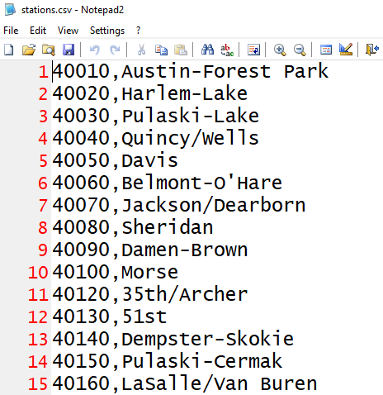
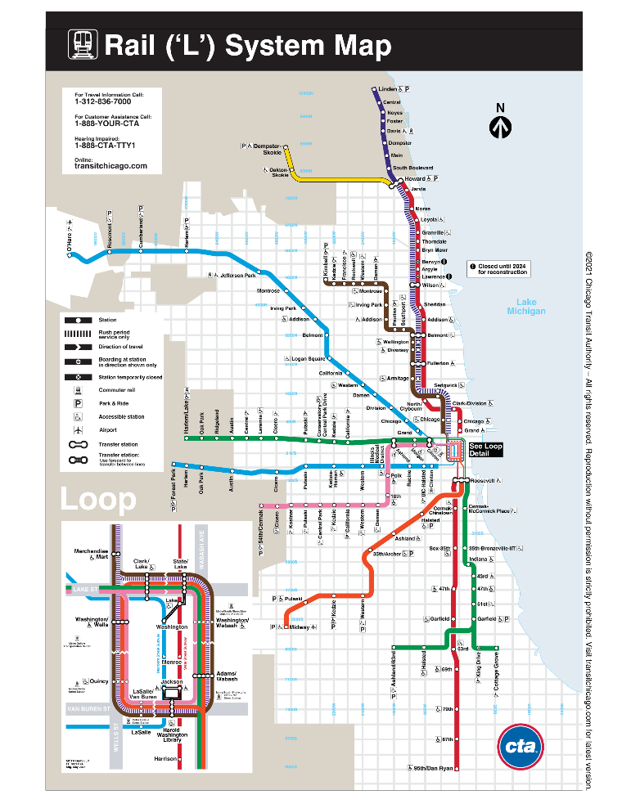
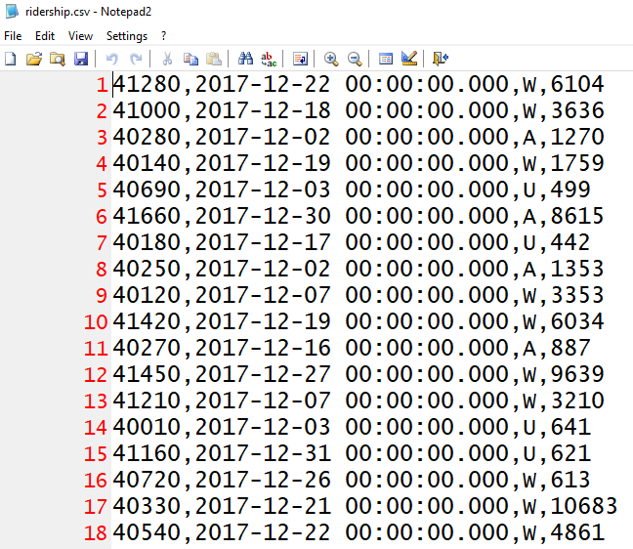
Database example: CTA
We have some CTA ridership data (L stations) that we need to analyze…

Slide 13
CTA database (subset)
Station_ID | Station_Name
40010 | Austin-Forest Park
40020 | Harlem-Lake
40030 | Pulaski-Lake
… | …
table: Stations
CTA.db
Station_ID | Ride_Date | Type_of_Day | Num_Riders
41280 | 2017-12-22 00:00:00.000 | W | 6104
40010 | 2017-12-28 00:00:00.000 | W | 1155
40280 | 2017-12-02 00:00:00.000 | A | 1270
40030 | 2017-12-24 00.00.00.000 | U | 595
… | … | … | …
table: Ridership

Slide 14
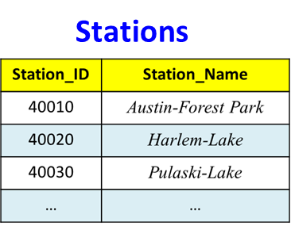
Example #1
The closest L station is “Noyes”
What is the station ID?
Answer: 40400
select Station_ID from Stations where Station_Name = 'Noyes';
Observations…
SQL language is case insensitive (select or Select or SELECT)
Data is case sensitive (try ‘noyes’)

Slide 15
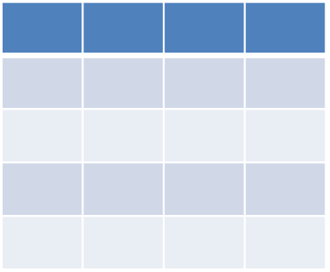
Select
For retrieving data from a database
General format:
The result is *always* a table
SELECT <<the data you want>>
FROM <<table(s)>>
[ WHERE <<condition(s)>> ]
[ GROUP BY <<one or more fields>> ]
[ HAVING <<condition(s)>> ]
[ ORDER BY <<one or more fields>> ]
;
optional
Notes:
Ignore the optional stuff for now…

Slide 16
Example #2
List all the L stations in alphabetical order:
select Station_ID, Station_Name
from Stations
order by Station_Name Asc;

Slide 17
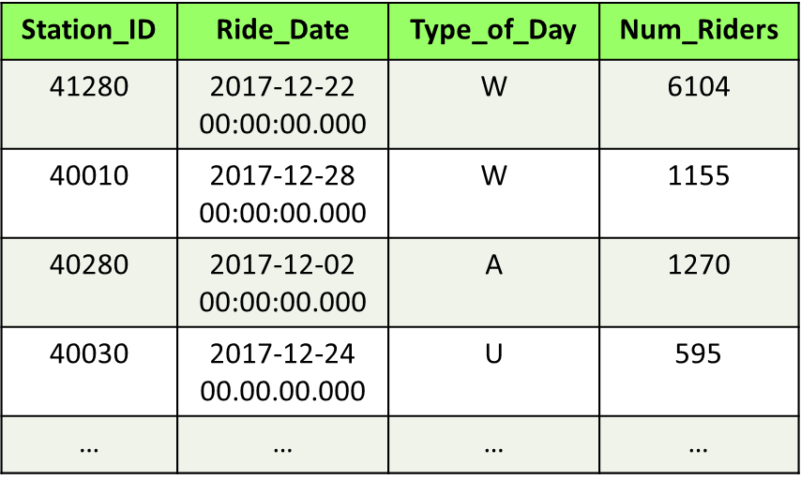
Example #3
What is avg daily ridership @ Noyes (station 40400)?
Answer: 592.793
select avg( ??? ) from Ridership where Station_ID = ???;
Notes:
SQL is a programming language with built-in functions
Use round(value, places) if you want to round the answer
Ridership
Notes:
-- Note that numbers don’t require the usage of …’, since numbers won’t contain spaces
Select ROUND(AVG(Num_Riders), 3) from Ridership where Station_ID = 40400;

Slide 18
Query
select round(avg(Num_Riders), 3)
from Ridership
where Station_ID = 40400; -- 'Noyes' station
Notes:
-- Note that numbers don’t require the usage of …’, since numbers won’t contain spaces
Select ROUND(AVG(Num_Riders), 3) from Ridership where Station_ID = 40400;

Slide 19
Computation
Like most languages, SQL can perform computation
Example:
What do you think this computes?
Select
cast((Select sum(Num_Riders) From Ridership Where Station_ID = 40400) as float) /
cast((Select sum(Num_Riders) From Ridership) as float) *
100.0;
Notes:
% of Noyes riders using the L

Slide 20
SQL is a full programming language
SQL has variables, if stmts, loops, functions, classes, etc.
Declare @total as float;
Declare @noyes as float;
Set @total = (Select sum(Num_Riders) From Ridership);
Set @noyes = (Select sum(Num_Riders) From Ridership Where Station_ID = 40400);
Select @noyes/@total * 100.0;
If @noyes is NULL -- incorrect station id
Select 0
Else
Select @noyes/@total * 100.0;

Slide 21
That's it, thank you!

